Slide 1
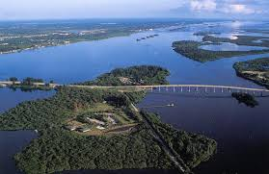
2024 IRL Envirothon’s Aquatic Ecology Station

Slide 2
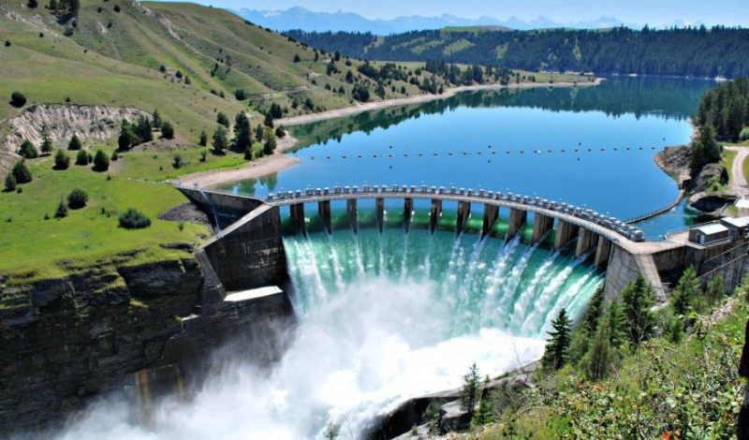
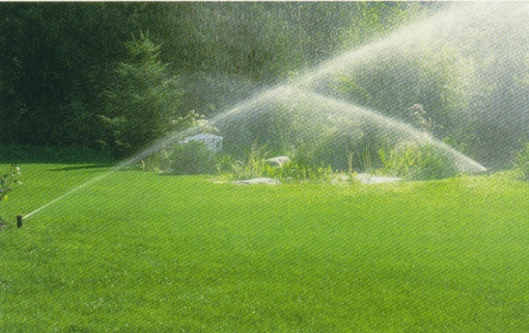
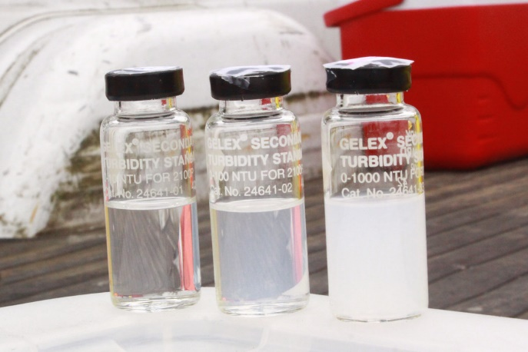
Focal Points
Most of the questions are linked to water conservation, sustainable practices involving water and renewable energy, and storm water, so keep that theme in mind when studying:
How will development effect water quality?
What are the pros and cons of water conservation when involving human alterations to the natural environment?
What would scientists look for in the field to indicate impaired water systems?
How do scientists test turbidity and how do
changes effect the wildlife?
What is affected by rain events?

Slide 3
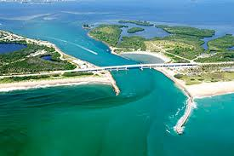
Focal Point (cont.)
Remember where we live! Several questions will tie the IRL and our area to aquatic studies.
How do we impact our surroundings?
Where does our water come from and what are we connected to?
What are normal conditions in our area and how will manmade structures change them?

Slide 4
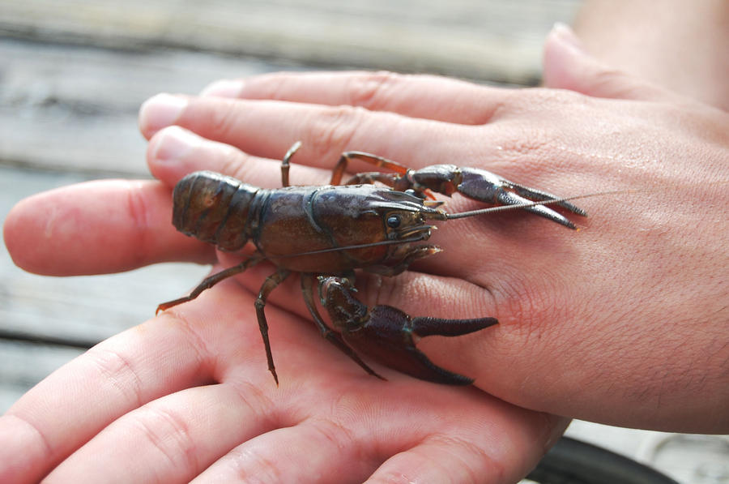
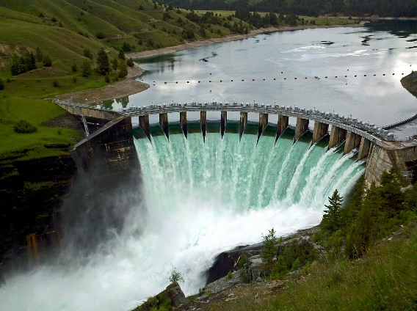
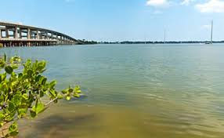
What should you see in water bodies?
Aquatics’ focus is water quality changes from using renewable energy sources this year.
Remember why the plants/animals are important to the ecosystem and what happens if we remove them or increase their population.
Consider freshwater impacts to the ecosystem.
Remember BMPs and how to apply them.
What are visual cues that something is wrong?

Slide 5
The Breakdown
The written portion is mostly about water quality, where our water comes from, and stormwater protection.
The poster portion is mostly about water quality. Again, remember to look at watersheds as a whole.
For the demonstration portion, think about how scientists collect water samples for turbidity.
The oral question is a situation that links the current issue to aquatics.

